Slide 1
POWER BI CAPSTONE-1 UNIVERSAL MARKETING DATA
-YASWANTH

Slide 2
DAX MEASURES
1)In the Calendar table, add a column named "Weekend"
If the day name is weekdays equals "N" otherwise "Y“
--week end = IF('Calendar'[name of day] == "Sunday" || 'Calendar'[name of day] == "Saturday", "Y", "N")
2) In the Calendar table, add a column named "End of Month"
Returns the last date of the current month for each row
--end of month = ENDOFMONTH('Calendar'[date])
3) In the Customers table, add a column named "Current Age“
Calculates current customer ages using the "birthdate" column and the TODAY() function
-- Current Age = YEAR(TODAY()) - Customers[Birth_year]
4) In the Customers table, add a column named "Priority"
Equals "High" for customers who own homes and have Golden membership cards (otherwise "Standard")
--priority = IF(Customers[homeowner] == "Y" && Customers[member_card] == "Golden", "High", "Standard")
5) In the Customers table, add a column named "Short Country"
Returns the first three characters of the customer country, and converts to all uppercase
-- Short_country = UPPER(LEFT(Customers[Country], 3) )

Slide 3
6) In the Customers table, add a column named "House Number"
Extracts all characters/numbers before the first space in the "customer_address" column (hint: use SEARCH)
--House number = LEFT(Customers[customer_address],SEARCH(" ", Customers[customer_address]))
7) In the Products table, add a column named "Price Tier"
Equals "High" if the retail price is >$3, "Mid" if the retail price is >$1, and "Low" otherwise
--Price tier = IF(Products[product_retail_price] < 1, "Low", IF(Products[product_retail_price] < 3, "Mid", "High"))
8) In the Stores table, add a column named "Years_Since_Remodel"
Calculates the number of years between the current date (TODAY()) and the last remodel date
--years since remodel = YEAR(TODAY()) - YEAR(Stores[last_remodel_date])

Slide 4
In the REPORT view, add the following measures (Assign to tables as you see fit, and use a matrix to match the "spot check" values)
1)Create new measures named "Quantity Sold" and "Quantity Returned" to calculate the sum of quantity from each data table
Spot check: You should see total Quantity Sold = 833,489 and total Quantity Returned = 8,289
--Quantity Sold = SUM(Transactions_data[quantity])
--Quantity Returned = SUM(Return_data[quantity])
2)Create new measures named "Total Transactions" and "Total Returns" to calculate the count of rows from each data table
Spot check: You should see 269,720 transactions and 7,087 returns
--Total Transactions = COUNTROWS(Transactions_data)
--Total Returns = COUNTROWS(Return_data)
3)Create a new measure named "Return Rate" to calculate the ratio of quantity returned to quantity sold (format as %)
Spot check: You should see an overall return rate of 0.99%
--Return Rate = [Quantity Returned]/[Quantity Sold]
4)Create a new measure named "Weekend Transactions" to calculate transactions on weekends
Spot check: You should see 76,608 total weekend transactions
--Weekend Transactions = CALCULATE(COUNTROWS(Transactions_data), 'Calendar'[week end] == "Y")
5)Create a new measure named "% Weekend Transactions" to calculate weekend transactions as a percentage of total transactions (format as %)
Spot check: You should see 28.4% weekend transactions
--% Weekend Transactions = DIVIDE(CALCULATE(COUNTROWS(Transactions_data),'Calendar'[week end] == "Y"), [Total Transactions],"ABC")

Slide 5
6)Create new measures named "All Transactions" and "All Returns" to calculate grand total transactions and returns (regardless of filter context)
Spot check: You should see 269,720 transactions and 7,087 returns across all rows (test with product_brand on rows)
--All Transactions = COUNTROWS(Transactions_data)
--All Returns = COUNTROWS(Return_data)
7)Create a new measure to calcul ate "Total Revenue" based on transaction quantity and product retail price, and format as $ (hint: you'll need an iterator)
Spot check: You should see a total revenue of $1,764,546
--Total_revenue = SUMX(Transactions_data,Transactions_data[quantity]*RELATED(Products[product_retail_price]))
8)Create a new measure to calculate "Total Cost" based on transaction quantity and product cost, and format as $ (hint: you'll need an iterator)
Spot check: You should see a total cost of $711,728
--Total cost = SUMX(Transactions_data,Transactions_data[quantity]*RELATED(Products[product_cost]))
9)Create a new measure named "Total Profit" to calculate total revenue minus total cost, and format as $
Spot check: You should see a total profit of $1,052,819
--Total profit = [Total_revenue]-[Total cost]
10)Create a new measure to calculate "Profit Margin" by dividing total profit by total revenue calculate total revenue (format as %)
Spot check: You should see an overall profit margin of 59.67%
--Profit Margin = DIVIDE([Total profit],[Total_revenue])

Slide 6
11)Create a new measure named "Unique Products" to calculate the number of unique product names in the Products table
Spot check: You should see 1,560 unique products
--Unique products = DISTINCTCOUNT(Products[product_name])
12)Create a new measure named "YTD Revenue" to calculate year-to-date total revenue, and format as $
Spot check: Create a matrix with "Start of Month" on rows; you should see $872,924 in YTD Revenue in September 1998
--YTD Revenue = CALCULATE([Total_revenue],DATESYTD('Calendar'[date]))
13)Create a new measure named "60-Day Revenue" to calculate a running revenue total over a 60-day period, and format as $
Spot check: Create a matrix with "date" on rows; you should see $97,570 in 60-Day Revenue on 4/14/1997
-- 60-day Revenue = CALCULATE([Total_revenue],DATESINPERIOD('Calendar'[date],MAX('Calendar'[date]),-60,DAY))
14)Create new measures named "Last Month Transactions", "Last Month Revenue", "Last Month Profit", and "Last Month Returns"
Spot check: Create a matrix with "Start of Month" on rows to confirm accuracy
--Last month revenue = CALCULATE([Total_revenue],DATEADD('Calendar'[date],-1,MONTH))
--Last month profit = CALCULATE([Total profit],DATEADD('Calendar'[date],-1,MONTH))
-- Last month transactions = CALCULATE([Total transactions],DATEADD('Calendar'[date],-1,MONTH))
--Last month returns = CALCULATE([Total returns],DATEADD('Calendar'[date],-1,MONTH))
15)Create a new measure named "Revenue Target" based on a 5% lift over the previous month revenue, and format as $
Spot check: You should see a Revenue Target of $99,223 in March 1998
Revenue target = [Last month revenue]*1.05

Slide 7
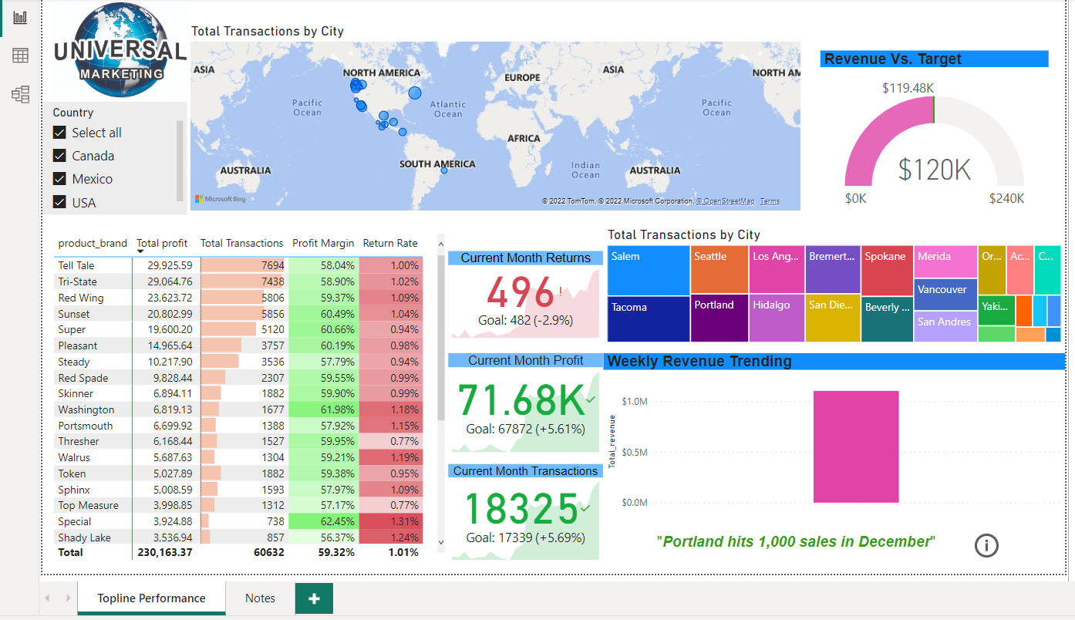
DASHBOARD

Slide 8
Thank you

